Slide 1
reference model for real-time systems
Lecturer: Bui Ha Duc, PhD
Department of Mechatronics

Slide 2
Reference model
Reference model let us reason about real-time systems:
  Standardization: Provides a common language for discussing real-time systems
  Analysis Framework: Enables the analysis of system properties like feasibility and optimality
  Performance Evaluation: Offers metrics to assess the effectiveness of scheduling algorithms
  Let’s us to focus on the important aspects of a system while ignoring the irrelevant properties and details
Reference model of Real-time system is characterized by:
  Workload Model: Describes the applications and tasks that the system must execute
  Resource Model: Details the hardware and software resources available to the workload
  Scheduling Algorithms: Define the rules for allocating resources to tasks over time

Slide 3
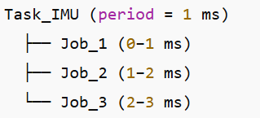
Common Terms
Basic unit: tasks and jobs
Process: an independent program in execution
  Each process can contain multiple threads
  In small RTOS systems, we often run only one process → Process = Task
Task: a work that executes repeatedly to perform a specific function in the system
  E.g: read IMU sensor, apply filter on sensor data
  A Task can generate multiple jobs during execution
Job: is a single execution instance of a task
  E.g:

Slide 4
Designing a real-time system
Step 1: Define System Objectives and Requirements
  Define system purpose
  List functional requirements
  Define real-time requirements
  Identify performance constraints

Slide 5
Example
Design Flight controller for Drone
Step 1: System objectives
Maintain stable attitude at control rate 250 Hz (every 4 ms)
Read IMU at 1 kHz (every 1 ms)
Run sensor fusion at 500 Hz (every 2 ms) to produce state estimate
Update motor PWM output within 1 ms of control output
Telemetry at 50 Hz for ground station

Slide 6
Designing a real-time system
Step 2: Model the System
  Define task types
  Identify critical tasks
  Describe the workload model
    Temporal parameters
    Relationship between task
  Define resource model
    cpu, platform, shared resources
  Represent interactions via task graph or data flow diagram

Slide 7
Types of task
Tasks are primarily classified based on their arrival patterns
Periodic Tasks: A set of jobs that are executed repeatedly at regular time intervals.
  They are predictable and their timing parameters are usually well-defined → hard real-time
Aperiodic Tasks: These tasks arrive at irregular, unpredictable intervals in response to random events.
  Their execution requirements are typically soft real-time
Sporadic Tasks: These tasks also arrive at irregular, but they have a guaranteed minimum arrival time between arrivals.
  Their execution requirements are usually hard real-time

Slide 8
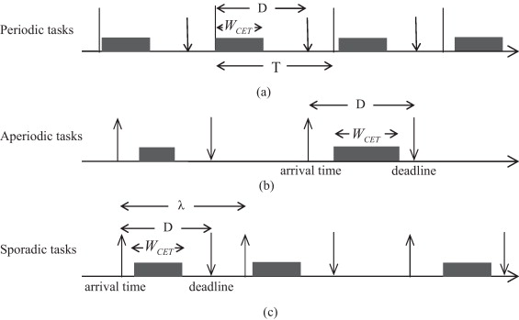
Types of task

Slide 9
Criticality
Hard deadline: All the deadlines must be met
  If any hard deadline is ever missed → the system is incorrect
  Hard real-time system is a system that all deadlines are hard
  E.g. Nuclear power plant control, flight control
Soft deadline: some deadline may occasionally be missed
  “occasionally” ??? → use probabilistic requirement, e.g <1%
  Soft real-time system: A system in which some deadlines are soft.
  E.g. Telephone switches, video streaming
Firm deadline: missed deadlines are simply discarded, as their results are no longer useful.

Slide 10
Example
Design Flight controller for Drone
Step 2: Model the System
Task | Description | Type | Criticality
T₁ – Read IMU | Read IMU at 1 kHz | ? | ?
T₂ – Sensor Fusion | Run sensor fusion at 500 Hz | ? | ?
T₃ – Altitude control | Maintain stable attitude at control rate 250 Hz | ? | ?
T₄ – Motor Update | Update motor PWM output within 1 ms of control output | ? | ?
T₅ – Telemetry | Communication with ground station at 50 Hz | ? | ?

Slide 11
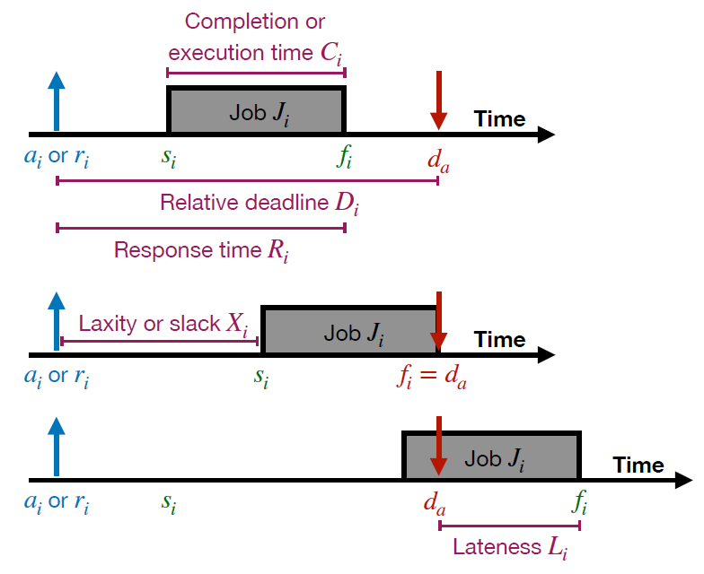
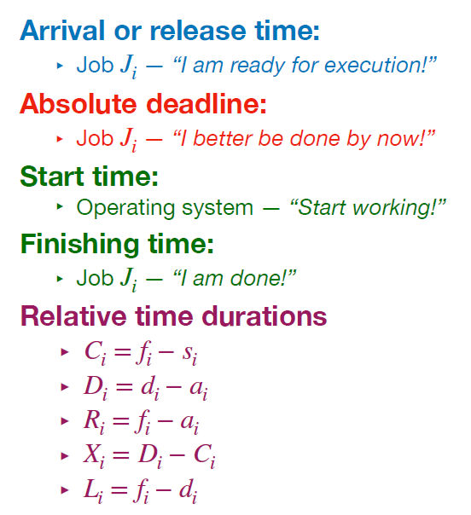
Temporal Parameters
i
i
i

Slide 12
Temporal parameters
For each job or task, a set of parameters defines its timing behavior and constraints
Execution time C_{i}: Time required to complete the execution of J_{i} when it executes alone and has all the resources it needs
  Value of C_{i} depends upon complexity of the job and speed of the processor
  Determine the exact value of C_{i} might be difficult → estimate the worst-case execution time WCET

Slide 13
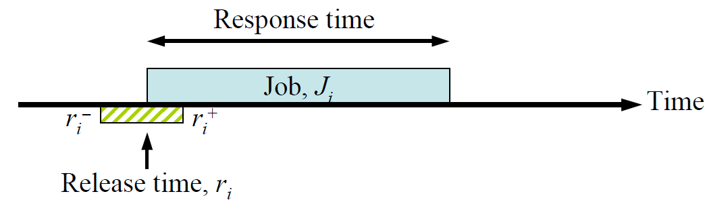
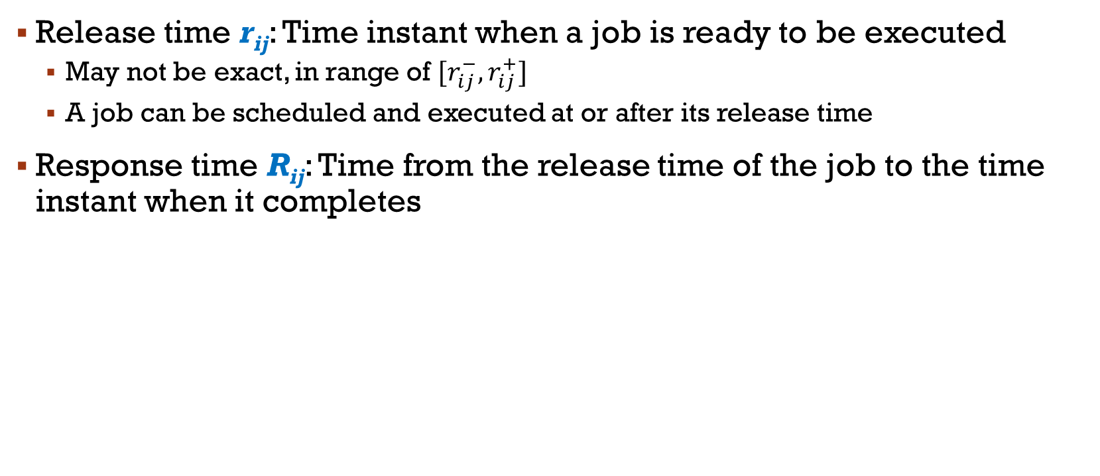
Temporal parameters
Release time r_{ij}: Time instant when a job is ready to be executed
  May not be exact, in range of $[r_{ij}^{−},r_{ij}^{+}]$
  A job can be scheduled and executed at or after its release time
Response time R_{ij}: Time from the release time of the job to the time instant when it completes

Slide 14
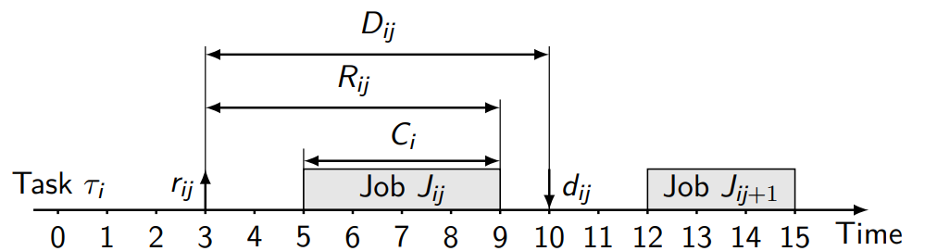
Temporal parameters
Relative deadline D_{ij} – the maximum allowable job response time
Absolute deadline d_{ij} : the instant of time by which a job is required to be completed
  Absolute deadline = release time + relative deadline
  Feasible interval for a job J_{ij} is the interval (r_{ij}, d_{ij}]

Slide 15
Resources model
Resources in real-time systems are broadly categorized into two main types
Active resources (Processors): is an active component on which jobs scheduled
  E.g. STM32R103 – one core MCU, max 72MHz
Passive Resources (Shared/Logical Resources): These are items needed in addition to processors
  E.g. Bus (I2C/SPI); timers for interrupt; timer for PWM; UART

Slide 16
Example
Design Flight controller for Drone
Step 2: Model the System
Task | Type | Period p (ms) | WCET C (ms) | Deadline D (ms) | Criticality | Priority
T₁ – Read IMU
T₂ – Sensor Fusion
T₃ – Altitude control
T₄ – Motor Update
T₅ – Telemetry
*WCET must be measured on target hardware

Slide 17
Task relationship
The workload model also accounts for relationships between tasks
Precedence Constraints: Some jobs must execute in a specific order. These dependencies are often modeled using a task graph
Resource Dependencies: Jobs may require access to shared passive resources (like memory buffers or databases) and must coordinate their access using synchronization primitives

Slide 18
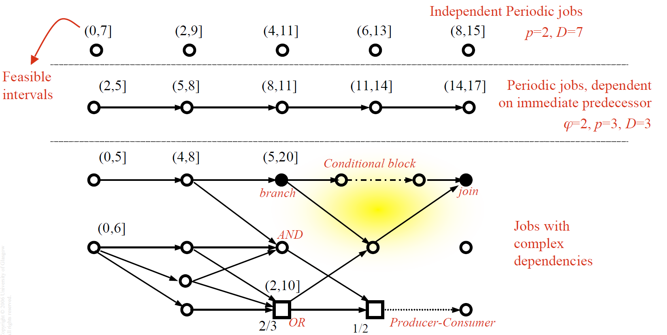
Task Graph
A task graph is a formal model that represents a set of computational jobs and the dependencies between them
  Nodes represent individual jobs or computational units
  Edges represent the dependencies or precedence constraints between jobs

Slide 19
Example
T₄
T₁
T₂
T₃
T₅

Slide 20
Designing a real-time system
Step 3: Select Scheduling and Synchronization Strategies
  Choose a scheduling algorithm
  Perform schedulability analysis
  Define resource-sharing protocols
  Plan for interrupt handling and task preemption

Slide 21
Real-time scheduling
Real-Time Scheduling
Online Scheduling
Static Priority Scheduling
Dynamic Priority Scheduling
Offline Scheduling
Clock-Driven Scheduling
Rate Monotonic Scheduling
Deadline Monotonic Scheduling
Earliest Deadline First
Least Laxity First

Slide 22
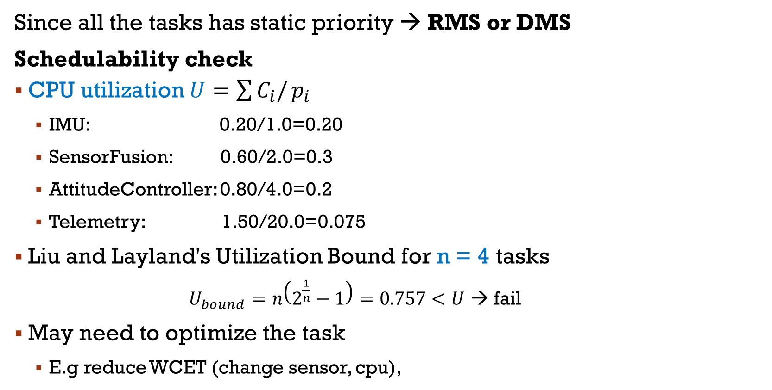
Example
Since all the tasks has static priority → RMS or DMS
Schedulability check
CPU utilization $U=\sum{C_{i}/}p_{i}$
  IMU: 0.20/1.0=0.20
  SensorFusion: 0.60/2.0=0.3
  AttitudeController: 0.80/4.0=0.2
  Telemetry: 1.50/20.0=0.075
Liu and Layland's Utilization Bound for n = 4 tasks
  $U_{bound}=n\left(2^{\frac{1}{n}}−1\right)=0.757<U$ → fail
May need to optimize the task
  E.g reduce WCET (change sensor, cpu),
U=0.775 (77.5% cpu)

Slide 23
Designing a real-time system
Step 4: Select Hardware and RTOS
  Select hardware platform
  Choose an RTOS
Step 5: Design and Implement Software Architecture
  Implement each task with clear timing control
  Implement priority-based preemption
  Ensure fault isolation — one task’s failure shouldn’t crash the system
Step 6: Perform Timing and Functional Verification
  Measure response times, jitter, CPU utilization.
  Use simulation or trace tools
  Test under worst-case conditions

Slide 24
Designing a real-time system
Step 7: Optimize and Validate
  Optimize task code (reduce WCET)
  Tune scheduling parameters
  Validate system in real environment
Step 8: Safety, Fault Tolerance, and Maintenance
  Add watchdog timers and error recovery mechanisms
  Design redundancy for critical functions

Slide 25
Exercise
Conduct step 1-3 for the below system
Autonomous Car
  Camera capture
  Lane detection
  Obstacle detection (YOLO)
  PID control
  Dashboard display update

Slide 26
Exercise
Conduct step 1-3 for the below system
Robotic Arm Controller
  Encoder reading
  Kinematics calculation
  Inverse dynamics control
  Motor PWM update
  Safety monitor

